Slide 1
How Visualizing Inferential Uncertainty Can Mislead Readers About Treatment Effects in Scientific Results
Jake M. Hofman,
Daniel G. Goldstein,
Jessica Hullman

Slide 2
Introduction​
Experiment 1
Result 1
Experiment2
Result 2
Questions​

Slide 3
introduction
When presenting visualizations of experimental results, scientists often chose to display either inferential uncertainty (i.e., the precision of statistical estimates) or outcome uncertainty(i.e., the predictability of individual outcomes).
A distinguishing feature between the two is that inferential uncertainty can be reduced by collecting and analyzing more data, whereas outcome uncertainty cannot.
Here, the research shows that this can lead to sizable misperceptions about the implications of scientific results or how does this choice impact readers beliefs about the treatments.
To understand what is best for the readers, 2 experiments were performed comparing 95% confidence intervals (means and standard errors) to 95% prediction intervals (means and standard deviations).
Notes:
For example: For instance, in a study of how heights vary by gender, inferential uncertainty captures how precisely one has estimated the average height of men and women based on the set of
measurements that were made. With a large enough sample, one can very precisely estimate the average height within each group. But this does not change the fact that there is a good
deal of outcome uncertainty, as individual heights within each group vary substantially around their respective averages.

Slide 4

Experiment:1
The 1st experiment was designed to measure the difference in how people perceive the same effect when it is communicated in one of two conventional methods (a) Inferential Uncertainty (population mean) and (b) Outcome Uncertainty (variation of outcomes around that mean).
The experiment was performed over 2400 people.
Participants were told that they were athletes competing in a boulder sliding game, playing against an equally skilled competitor named Blorg. The goal of the game is to slide a boulder on ice farther than the opponent’s boulder. There is an all-or-nothing 250 Ice Dollar prize for the contestant who slides their boulder the farthest.
Participants were given the opportunity to rent a superior boulder (i.e., undergo a treatment) that is expected (but not guaranteed) to increase their sliding distance for their next and final competition.

Slide 5
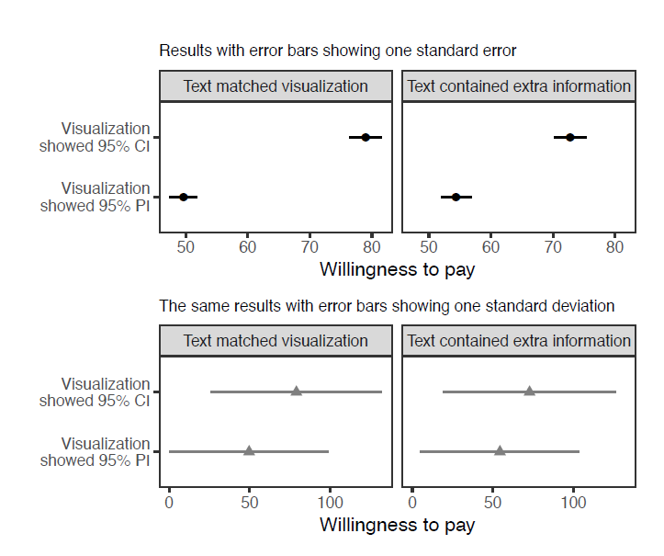
Result:1
They were then shown a visualization that provided statistics about both the standard and superior boulders with an accompanying caption.
We see that participants were willing to pay substantially more on average for the treatment when the visualization emphasized inferential uncertainty.
With that, it can be concluded that readers are expected to invest more on an experiment that has a higher mean irrespective of that the average could change or differ with just one +ve or –ve case of an individual.
Hence, the visualizations used by scientist can often mislead and thus it is preferred to use the Inferential uncertainty and outcome uncertainty side by side with extra captions/text so that a reader can make an informed choice.

Slide 6
Experiment: 2
At this point, we all understand how crucial it is to create an accurate and effective visualization to provide the data to audiences.
From experiment 1 we understand that showing data with inferential uncertainty or with outcome uncertainty has their own shortcomings. In Experiment 2, scientists have tried to give 2 alternate visualizations.

Slide 7
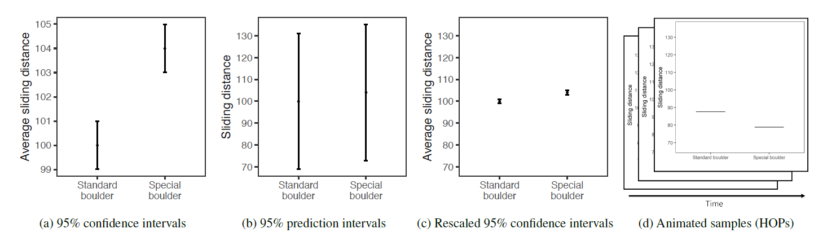
Result: 2
The first alternative visualization is shown in Figure (c), where error bars depict 95% CIs, but the vertical axis has been rescaled to accommodate 95% PIs. This relatively simple modification is similar to intentionally extending the y-axis range to include zero—as visualization experts sometimes advise—but has the benefit of conveying information about both inferential uncertainty, through the error bars, and outcome uncertainty, through the axis range.
The second alternative visualization is HOPs (Hypothetical Outcome Plots), which show uncertainty through a series of animated frames that depict samples from underlying distributions. The fraction of frames that samples from one distribution dominate samples from another. They are optimized for the task, providing a useful comparison point for readers.

Slide 8
Questions
Did anyone had a similar experience or encountered an identical challenge while looking for a treatment result or research?
Any suggestions with respect to the Experiment 2, to make the health-related data more accessible and easier to understand?
Do you agree that a layman might not be able to decode the data filled with technicalities (e.g., words like standard errors, mean, standard deviation)? Does it make reding articles like these difficult?

Slide 9
THANK YOU
- Alka Kumari

